Slide 1
Blockchain Scalability Problem
Sajan Maharjan
CSED601 Dependable Computing
20182095
28th Nov. 2018

Slide 2
Transaction Processing Speed
VISA & MasterCard Payment System – 24000 TPS
Bitcoin Blockchain – 3.3 to 7 TPS
Ethereum Blockchain – 15 to 20 TPS
If you want to pay for a cup of coffee in Bitcoin/Ethers, are you willing to wait for an hour/few minutes for confirmation of transactions?
This situation can be considered as an availability (readiness for service) issue of blockchain networks. [Also concerns with security]

Slide 3
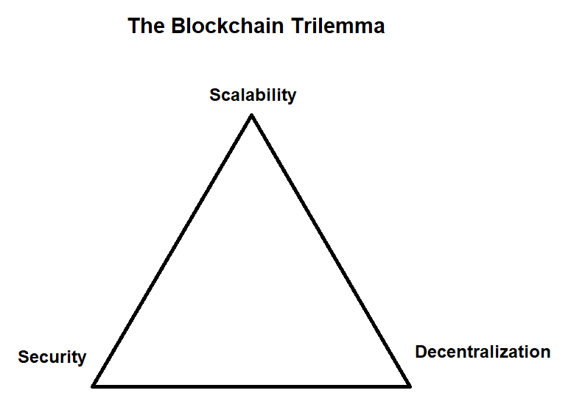
Scalability Trilemma
First coined by Vitalik Buterin
Concerns the issue of development of a scalable, decentralized and secure blockchain without compromising any of these properties
Image Source- https://www.jeffersoncapital.info/wp-content/uploads/2018/07/The-Blockchain-Trilemma.png

Slide 4
The Scalability Problem?
Early design of blockchain did not consider the widespread use
Although cannot handle large number of

